Slide 1
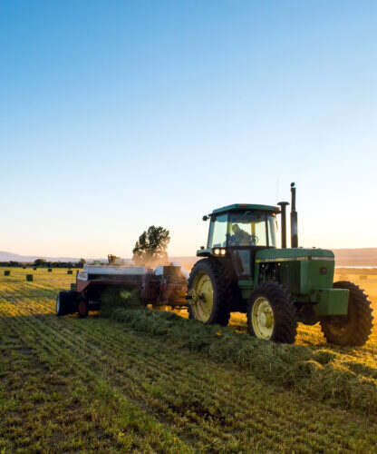
Revolutionizing Agricultural Equipment Financing
Introducing a digital marketplace to streamline the $14.6 billion agricultural equipment financing industry

Slide 2



Executive Summary
Opportunity
Core Problems
Our Solution
$14.6 billion North American market, projected to grow at 3.2% CAGR through 2030, but industry remains frozen in 1990s technology with fragmented workflows and poor data standardization.
Farmers wait 3-7 days for financing approvals, dealers manually manage 5-15 lender portals, wasting 30-40% of finance staff time, lenders rework 30-40% of applications due to incomplete data, costing $200-300 per application, OEMs lack real-time visibility into equipment financing trends and incentive ROI.
A neutral, dealer-embedded, multi-lender digital marketplace that standardizes workflows across dealers and lenders, enables instant multi-lender comparison for farmers, reduces underwriting costs by 20-30%, and provides OEMs real-time green equipment financing and incentive tracking.
The executive summary outlines the significant opportunity in the $14.6 billion North American agricultural equipment financing market, the core problems faced by stakeholders, and our comprehensive solution that addresses these challenges.

Slide 3
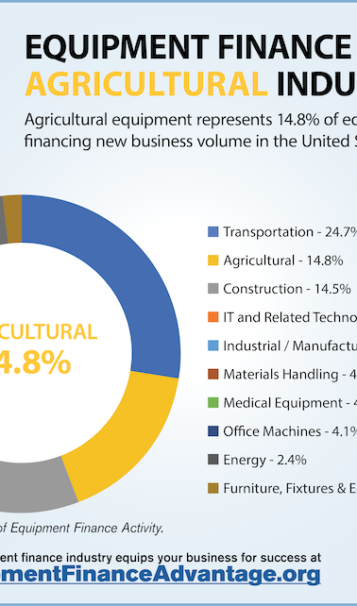
Why This, Why Now, Why Us
The $14.6 billion North American agricultural equipment financing market represents a significant opportunity. Now is the inflection point, with equipment prices up 35-40% and rural bank deposits down 15-22%, creating a perfect storm of demand for modernized financing solutions. Our team's deep fintech and ag-lending expertise, validated by 8 dealer interviews and 6 lender calls, positions us to address this critical market need.

Slide 4
Business Model & Unit Economics
Three Revenue Streams (Year 5 projection: $36-52M)
Unit Economics (Y5)
• Gross Margin: 78-82% (cloud infrastructure, standardized integrations) • CAC per Dealer: $3.8K with OEM partnerships (down from $5K) • CAC Payback: 4.5 months (sustainable model) • Net Retention: 100%+ (expansion revenue)
Stream Structure % Revenue Y5 Revenue Lender Fees 0.75-1.5% of funded loans 70% $25-39M Dealer SaaS $300-1,500/month (tiered) 25% $9-12M OEM Analytics $10-50K annually per OEM 5% $0.15-1M
Financial Highlights — Reality-Checked
Platform Penetration by Lender Type (Reality-Checked)
Metric Conservative Base Case Upside Y5 Dealers 600 750 950 Y5 Platform Volume $2.8B $3.6B $5.0B Y5 Revenue $22M $32M $43M Y5 EBITDA Margin 22% 28% 32% Exit Valuation (6x) $132M $192M $258M Seed Return (from $300K) 440x 640x 860x Profitability Path: Break-even Month 18-20 EBITDA positive Year 3 Exit Year 5
Lender Type Penetration Rate Notes Non-captive 50-70% Farm Credit, community banks interested in neutral distribution Captive finance 0-30% Unlikely to route through neutral platform; prefer their own Relationship lenders 20-40% Dealers have strong preferences; owner overrides common Blended reality 25-40% NOT 40-50% as originally assumed

Slide 5


Total Addressable Market (TAM)
Market Category
Value
Source
U.S. farm equipment purchases annually
$45-70 billion
USDA NASS 2024[8]
Tractors + self-propelled machinery
$21.0 billion (44% of total)
USDA NASS 2024[8]
Equipment financed vs. cash
$25-27 billion (45-55% penetration)
USDA ERS surveys[10]
Dealer-originated finance (our TAM)
$14.6 billion annually
Grand View Research[1], validated by primary interviews
*The U.S. farm equipment purchases market totals approximately $45-70 billion annually[8] across 2.1 million farms[9]. However, not all equipment is financed; farmers use a mix of cash, leasing, and debt instruments.

Slide 6
Serviceable Addressable Market (SAM)
45% of U.S. farm operations
8,000 dealers in 7-state region
85B in agricultural loans (Midwest)
Midwest focus
Equipment dealer density
Farm Credit presence
52% of equipment purchasing activity
280 active agricultural lenders
Midwest leads
Farm Credit, community banks, captive finance

Slide 7
Serviceable Obtainable Market (SOM)
Phased, Reality-Checked Dealer Adoption Model
Outlines a step-by-step plan for scaling from a pilot with 10-15 dealers to a mature Midwest presence of 750 dealers over a 5-year period.
Validation Pilot (Months 1-6)
Focuses on validating the core workflow with a small beta group of 10-15 dealers, integrating 2-3 lenders, and achieving $50 million in financed volume.
Midwest Expansion (Months 7-18)
Scales the platform from the pilot to 40-60 live dealers, expands the lender network to 8-12 partners, and aims to reach $1.2 billion in financed volume.
Regional Scale (Months 19-36)
Grows the dealer network to 300-400 across the Great Plains region, continues lender expansion to 25-35 partners, and targets $2.4 billion in financed volume while achieving profitability.
Mature Midwest (Months 37-60)
Solidifies the platform's position in the Midwest with 750 dealers, maintains a strong lender network, and reaches $3.6 billion in financed volume with a 28% EBITDA margin.
Five-Year Financial Projections
Provides a reality-checked, phased forecast for dealer count, platform volume, revenue, EBITDA margin, and exit valuation across conservative, base case, and upside scenarios.

Slide 8







Macro Tailwinds
Rural Credit Crisis
Equipment Price Inflation
Dealer Digitization
Green Equipment Finance Growth

Slide 9
Stakeholder Pain Points
Key challenges faced by farmers, dealers, and lenders in the agricultural equipment financing market
7
Farmers: Time to Approval
Dealers: Time Spent on Multiple Portals
40
Lenders: Incomplete Application Rate
40
Lenders: Underwriting Cost per Approval
600

Slide 10



Platform Architecture
MVP (Months 1-4)
V2 (Months 5-12)
V3 (Months 13-24)
Core Workflow Validation: One application, multi-lender routing; Dealer portal with consolidated pending applications and real-time status; 2-3 lender integrations; Standardized data schema; Rules-based credit scoring.
AI-powered loan routing; Predictive credit scoring; OEM analytics dashboard; DMS integrations expanded; Mobile app for farmers.
Portfolio risk dashboards; Dealer performance benchmarking; White-label dealer portal; Adjacent asset classes (equipment leasing, farm land financing, crop financing).

Slide 11
Competitive Differentiation
Against Captive Finance
Against Regional Banks (Farm Credit)
Their Strength: Scale, integration depth, brand trust. Their Weakness: Single-lender only; Deere or CNH; farmers/dealers prefer multi-lender neutrality; captives cannot credibly claim neutrality. Our Position: We're the only neutral player. Farmers + dealers get Deere, CNH, Kubota in one app. Deere Financial excels at loyalty; we excel at efficiency.
Their Strength: Capital, relationships, board connections, local credit policy flexibility. Their Weakness: Rural distribution costly; dealer embedding weak; cannot build tech platform. Our Position: We solve your distribution problem without branch economics. Win-win: you stay competitive on rates; we embed at point-of-sale.
Against Ag-Fintech & Online Marketplaces
Against Dealer Portal Point Solutions
Their Strength: Speed, mobile-first UX, digital-native mindset. Their Weakness: Miss dealer workflow (70% of volume originates there); limited rural data; small lender networks; cannot integrate with DMS. Our Position: Fintech dealer-embedded. Mobile-first is table stakes. But you miss the dealer workflow. We embed at dealer point-of-sale where farmers actually shop for equipment.
Their Strength: Deep integrations with individual lender systems. Their Weakness: Single-lender per portal; dealer still juggles 5-15 portals; no consolidation. Our Position: Single-lender portals don't solve dealer consolidation. You need one unified workflow across all lenders, instant multi-lender comparison, and analytics. That's what we deliver.

Slide 12




Defensible Moat
Multi-Lender Neutrality
DMS Integration Lock-In
Rural Credit Data Asset
Embedded Dealer Distribution
No competitor can credibly match our neutral, dealer-embedded, multi-lender platform approach
$15-30K switching cost per dealer; 3-6 month integration commitment makes it prohibitive to switch
5 years of underwriting data builds predictive models competitors cannot replicate
70% of equipment finance volume originates at the dealer - we own that workflow
These four key factors - multi-lender neutrality, DMS integration lock-in, rural credit data moat, and embedded dealer distribution - create a sustainable competitive advantage that will be extremely difficult for competitors to match.

Slide 13






Financial Highlights
Revenue, EBITDA Margin, and Exit Valuation Scenarios
22
22
132
440
Revenue (M)
EBITDA Margin
Exit Valuation (M)
Seed Return

Slide 14
Funding Roadmap
Months 0-6
Seed: $250-300K - MVP with 10-15 dealer closed beta, 2-3 lender integrations, $50M financed volume
Months 18-20
Break-even: EBITDA positive, path to profitability
Months 15-18
Year 5
Series A: $4-6M - Platform scaling, geographic expansion, team to 20 FTE
$32M revenue, $9.1M EBITDA, 28% margin

Slide 15

In conclusion, this platform represents a transformative opportunity to modernize the $14.6 billion North American agricultural equipment financing industry. By addressing the core pain points of farmers, dealers, and lenders, we can unlock significant efficiency gains, cost savings, and new revenue streams. With our deep domain expertise, defensible moat, and phased go-to-market strategy, we are poised to become the industry's leading digital infrastructure provider. The time is right to revolutionize this fragmented market and deliver a new standard of convenience, transparency, and performance.

